Slide 1
Music Mood Lifter
CPEN291 Machine Learning Final Project
Presenter: David Zhang, Tuo Yang, Jack Le, Yisheng Liu

Slide 2
Introduction
Project overview
Data Collection
Model
Results
Other related functions
Web application

Slide 3

So what is Music Mood Lifter?
ML project
Detect faces from input images
Predict emotion
Random search enough songs
Classify moods of the songs
Recommend fitting music

Slide 4
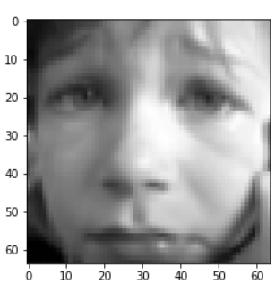
Emotion Detection Model
Data collection:
-FER2013

Slide 5
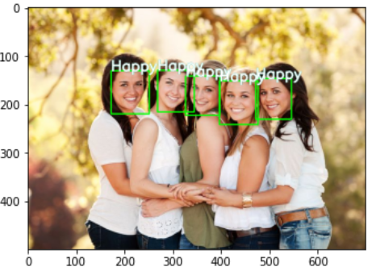
Emotion Detection Model
-OpenCV function

Slide 6
Emotion Detection Model
Base Model:
-Xception vs ResNet
Result:
-69% vs 25% validation accuracy

Slide 7

Music Mood Prediction Model
Data collection:
-data_mood.csv
-Spotipy, the API of Spotify

Slide 8
Music Mood Prediction Model
Base Model:
-Multiclass neural network
Result:
-82% validation accuracy

Slide 9
Video (TDB)
Demo Time...

Slide 10
Web Development

Slide 11

Why We Choose Django
Python Based
Multi Platform Supported
Fast
Secure

Slide 12


